Slide 1
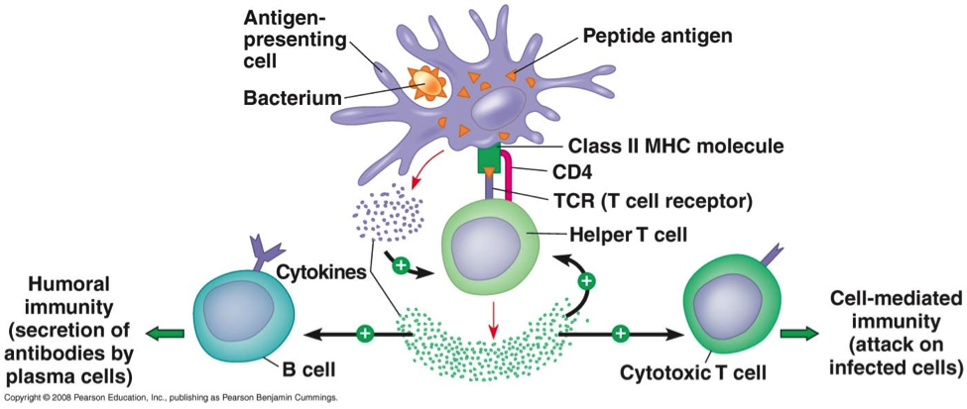
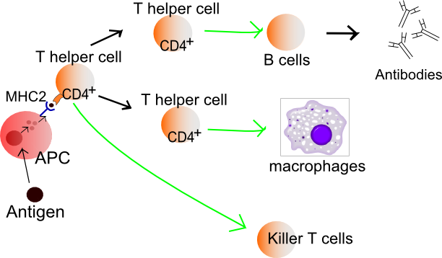
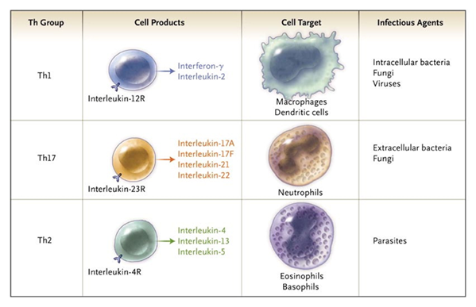
T –HELPER CELL AMMAR HADI
T-helper (T_{H})cells, as well recognize as CD4⁺ T cells, are types of T cells which are activated by Class II MHC molecules on Antigen introducing Cells (APCs).
They play an significant role in adaptive immunity and are produced in thymus
There are 3 main kinds of T-Helper cells: T_{H}0, T_{H}1, T_{H}2
T_{H}0 cells are simply undifferentiated precursors of T_{H}1 cells and T_{H}2 cells, while T_{H}1 and T_{H}2 cells are distinguished by the different kinds of cytokines they produce
T_{H}1 cells boost cytotoxic T lymphocyte (CTL) activity, activate macrophages, and mediate inflammation by make Interleukin (IL)-2, interferon (INF)-ɣ, tumor necrosis factor (TNF)-α.
These cytokines by T_{H}1 cells are responsible for delayed type (type IV) hypersensitivity reactions, in which host cell tissues are damaged non-specifically by activated T cells.
T_{H}2 cells tend to stimulate antibody responses in general, and defend against helminthic parasites by producing cytokines such as IL-4. IL-5, IL-6, IL-10 and IL-13.
An overabundance of T_{H}2 type responses may be involved in promoting allergic reactions.
Helper T- cells stimulate B-cells to produce more antibodies.

